Slide 1


Communication Round
One Shot Video
Complete Guidance

Slide 2
Communication Round
Section | Topic | No. of Ques
Section A | Reading & Listening | 18 Question
Section B | Speaking | 3 Question
Section C | Grammar | 34 Question
Section D | Comprehension | 15 Question

Slide 3
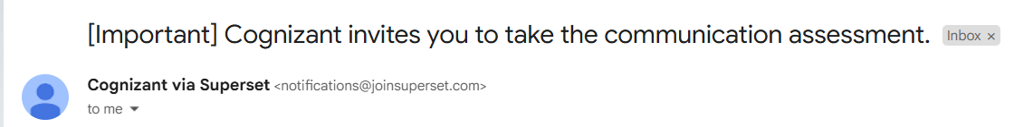
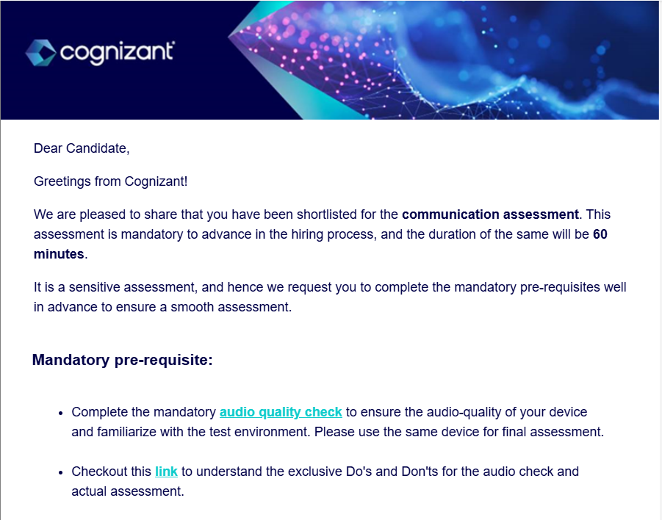

Slide 4
Mandatory pre-requisites
Complete the mandatory audio quality check to ensure audio-quality of the device and familiarize with the test environment. Recommend using the same device for final assessment.
Checkout this link to understand the exclusive Do’s and Don’ts for the audio check and actual assessment.
Install MSB and test it well in advance of the scheduled assessment date to avoid any complications at the time of launch of the assessment. Refer to the installation guide.
Ensure desktop / laptop audio socket is in proper working condition and able to detect mic and the incoming voice.
Ensure webcam is functional and well connected. You will be monitored via webcam during the assessment
Require minimum 2 mbps speed with stable internet connection.
Recommend using USB connector with a mounted mic or a very good quality in-line mic. If not, audio quality problems might arise

Slide 5
Important points:
Perform the audio quality check mentioned above as part of your system readiness check and any required installation / configuration. This check is only an audio device test & not the actual assessment. The audio device used for the audio quality check is recommended to be used for the final assessment as well.
Use "Check System Compatibility" link at the top to perform system readiness check and any required installation / configuration.
Ensure that the voice through microphone is detected very clearly through the desktop / laptop.
Ensure to have consistent and uninterrupted high speed internet connectivity – as the assessment has audio listening questions that can be played only once, beyond which it would be disabled.
Do not press F5 or refresh during the assessment – as it would auto-submit and end the assessment
Hit "Start Test" link only at the specified test commencement time as it will be enabled only then.
Assessment has more than 1 section, so do not click ‘Finish Test’ button until all the sections are completed. Upon clicking ‘Finish Test’, a summary of the completed sections and pending sections will be shown. Please review it.Complete each section within the allocated time as they are time bound. It will automatically move to next section when the time is up.
Only one attempt is available. Ensure laptop battery is fully charged / desktop is powered throughout the assessment duration and you have uninterrupted internet connection. Install MSB and perform all system checks well in advance.
In case you are facing an issue while launching MSB, please refer to the trouble shooting document.
In case of any disconnection due to power failure or internet issue, please restart your assessment immediately using the same invitation link

Slide 6
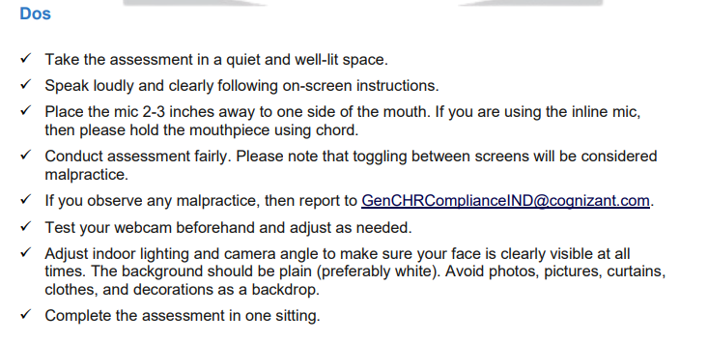
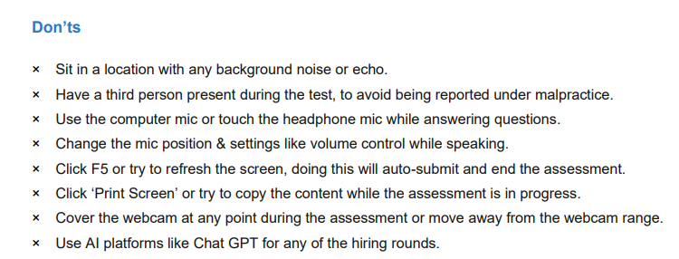

Slide 7
Reading & Listening Section
Please read the sentence as instructed.
He drinks coffee every morning.
I wrote a poem yesterday.
The children played football in the field
The dog barked loudly.
Please Read sentence one

Slide 8
Reading & Listening Section
Please repeat each sentence that you hear
You hear
You say
"I like to start my day with a cup of coffee."
"I like to start my day with a cup of coffee."

Slide 9

MASSIVE SUCCESS RATE
"Transform Your Interview Opportunity into an Offer Letter and Make Your Parents Proud!"
In-depth Technical Mock
Crack coding challenges with real experts.
HR & Managerial Prep
Master behavioral questions and impress TCS Interviewer.
Full Interview Simulation
Ace both technical and HR in one session.
Resume Review
Identify and fix weaknesses for a standout CV.
Personalized Feedback & Expert Guidance
Tailored improvement tips to boost success.
www.primecoding.in

Slide 10
Reading & Listening Section
Please give one or two word answer to the questions
You hear
You say
“"Does the sun rise from the east or the west?"
“from east” or “east”

Slide 11
Reading & Listening Section
Please rearrange the words into a correct sentence
You hear
You say
“his friend”...“a brand new watch”...“Rahul gifted”
“Rahul gifted his friend a brand new watch

Slide 12
Speaking Section
In this section, you will be given 3 topics on which you have to speak for 60 seconds each. You will have 90 seconds to think about each topic before you start recording
Note:
→ To help you speak on the topic, you are provided with speaking points in the form of questions.
→ Please note that the speaking points or questions are just suggestions.
→ If you wish, you may also speak on other points related to the topic.
Question 1: The Benefits of Regular Exercise.
Why is it important to exercise regularly?
What types of physical activities do you enjoy?
Can you describe a time when exercise made a positive impact on you?

Slide 13
Grammar Section
In this section, you will answer a total of 34 questions. The questions are divided into five categories. You have 15 minutes to complete all the questions, and each question is mandatory.
Verb Forms: Fill in the blank using the correct form of the verb provided in brackets. You will have a total of 8 questions.
Tenses: Fill in the blank using the appropriate tense provided in brackets. You will have a total of 8 questions.
Articles: Fill in the blank using the correct article to complete the sentence appropriately. You will have a total of 6 questions.
Prepositions: Fill in the blank using the appropriate tense provided in brackets.You will have a total of 6 questions.
Voice Change: Change the voice of the following sentences (active/passive) as required. You will have a total of 6 questions.

Slide 14

Comprehension Section
In this section, you'll listen to audio clips followed by a set of questions. You have 10 minutes to finish all the questions. Pay close attention to the audio, as the next three questions will be based on it.
Add a subheading
Q1: What solutions are suggested to address the challenges of urbanization?
Building more roads and highways to connect cities
Developing sustainable urban environments through green spaces and efficient public transport
Encouraging more people to move back to rural areas
Focusing solely on economic growth without considering social impact

Slide 15
Q2: Which of the following is NOT mentioned as a challenge resulting from urbanization?
Strain on public services
Increased agricultural output
Overcrowding
Environmental Degradation
Q3: Why people are migrating from rural to urban area ?
To meet their relatives
For better economic opportunity
To travel to new cities
To Have a change in day to day life

